Slide 1

CSE 464 : Software Quality Assurance and Testing
Fall 2018
Testing Web Applications - IV
Janaka Balasooriya

Slide 2
Service Oriented Application Testing

Slide 3
Web Service Architecture
Web Services
PDA
Cell phone
server
server
Work-
station
Laptop
Reference : Introduction to Software Testing by Ammann and Offutt

Slide 4
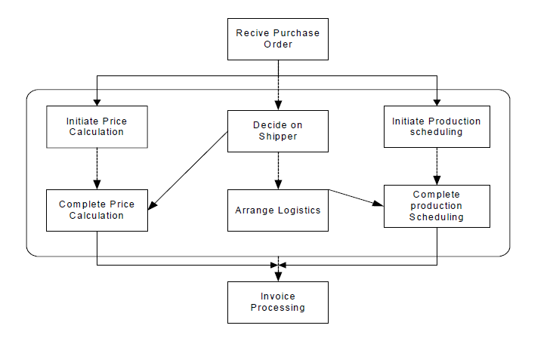
Web Service Application Example
Purchase Order Workflow

Slide 5
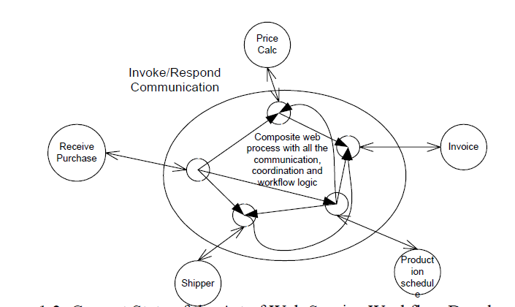
Web Service Application Example
Service Order Workflow Implementation

Slide 6
Main differences Between Component Based and SOA applications
Component based systems are usually tightly-coupled.
Web service applications are loosely coupled and the implementation/design is not available most of the time.
Web services can be dynamically bound at runtime

Slide 7
Different Set of Control Logic – Workflow control flow patterns
http://www.workflowpatterns.com/patterns/control/
AND-Split
Synchronous merge

Slide 8
Levels of Testing in SOA Applications
Test web services – at web service level
  Availability
  Response time
  Correctness of output
  Other quality factors …..
http://www.soapui.org/Getting-Started/your-first-soapui-project.html

Slide 9
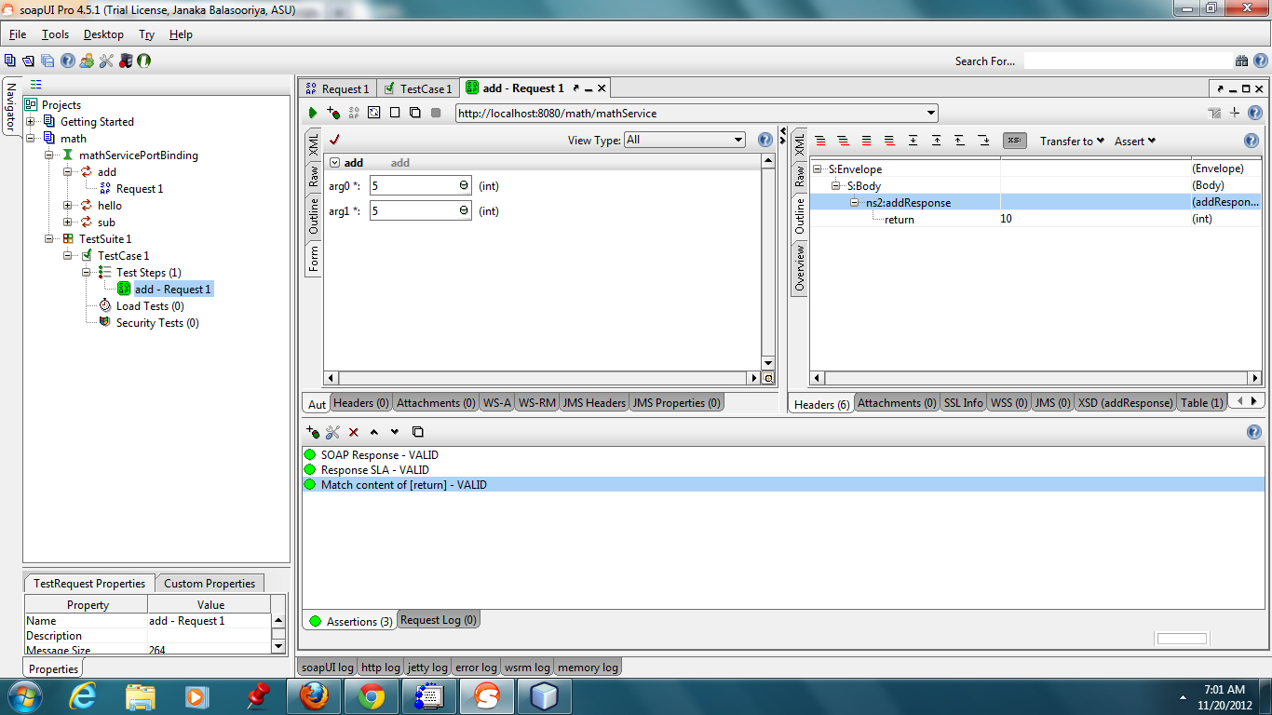
SoapUI/Web Service Demo
http://sourceforge.net/projects/soapui/files/

Slide 10
Web Service Composition Level Testing
Testing web service composition logic
How to model the behavior of a composite web service?
Behavior | Decision Table | Finite State Machine (FSM) | Petri-Net
Sequence | No | Yes | Yes
Selection | Yes | Yes | Yes
Repetition | No | Yes | Yes
Multiple-causes of output | Yes | Yes | Yes
Mutual Exclusion | No | No | Yes
Concurrency | No | No | Yes
Deadlock | No | No | Yes
Model Based Testing – Why Petri Net

Slide 11
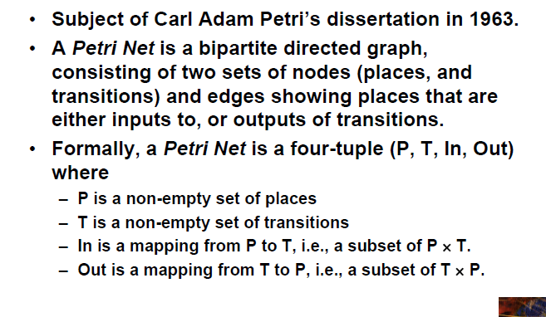
Petri-Net model for SOC Applications

Slide 12
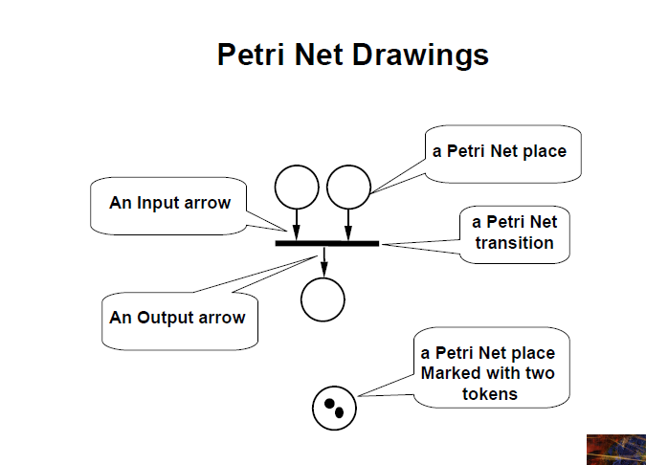

Slide 13
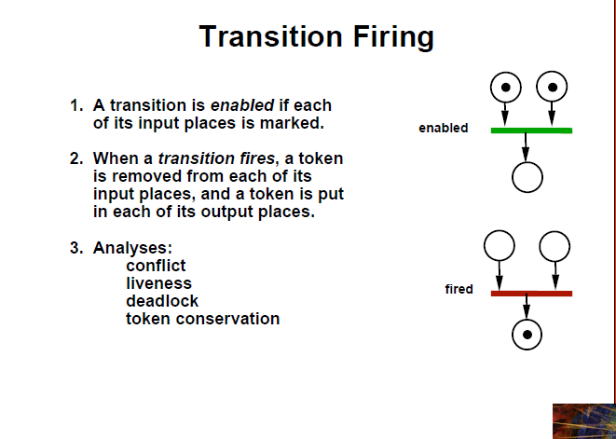

Slide 14
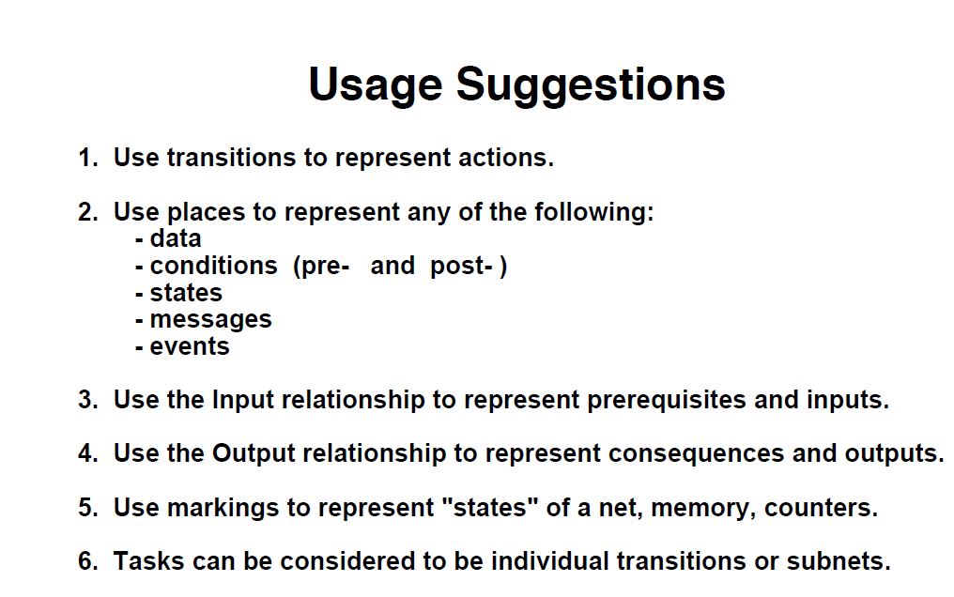

Slide 15
Model the purchase order workflow using Petri-Net

Slide 16
Petri-Net In-class activity

